Slide 1
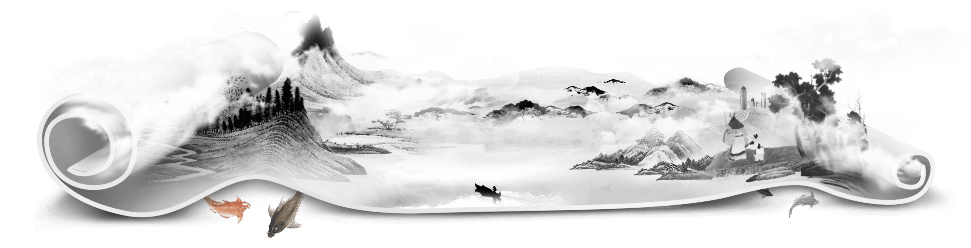
Titanic Disaster

Slide 2



Business Understanding
Data Exploratory Analysis
Data Preprocessing
Model Building

Slide 3
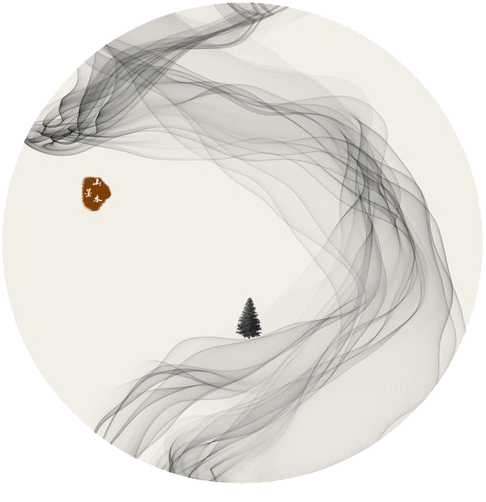
Business
Understanding

Slide 4
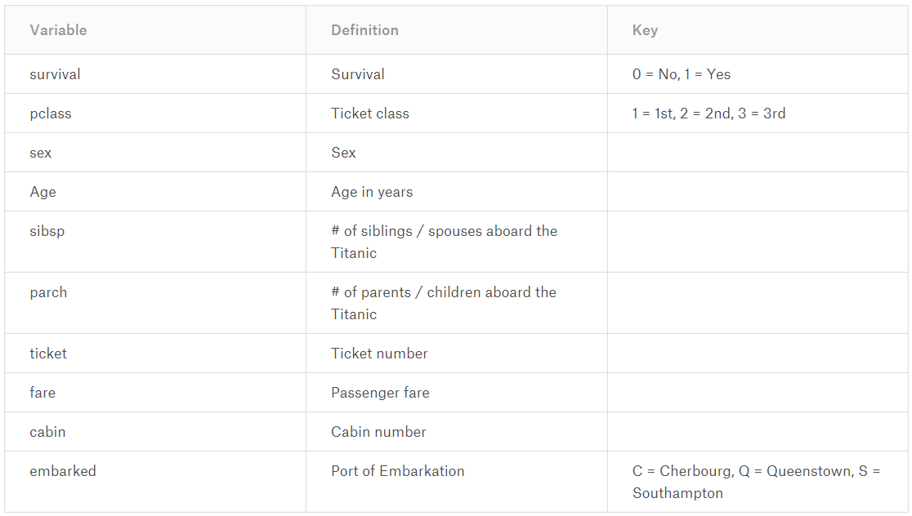


Business Understanding

Slide 5

Data Exploratory Analysis

Slide 6
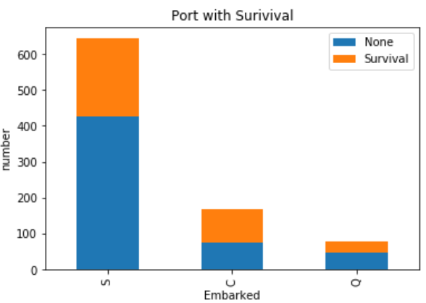
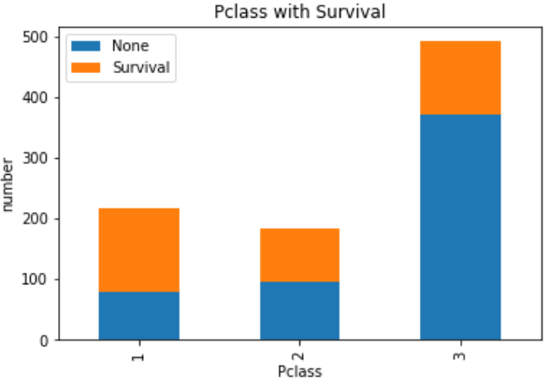
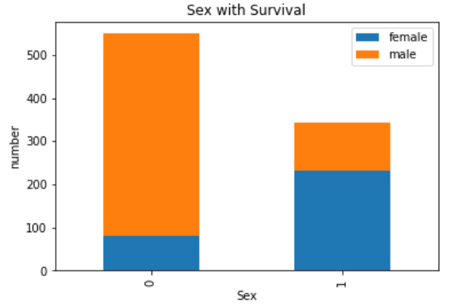
Data Exploratory

Slide 7
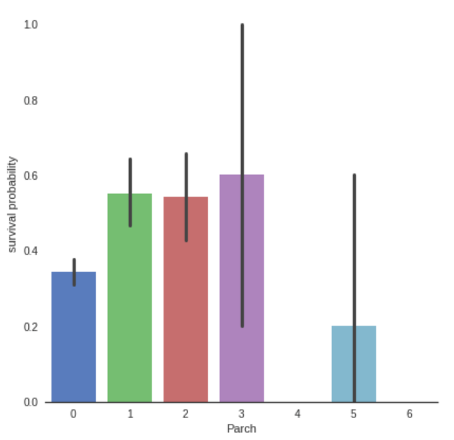
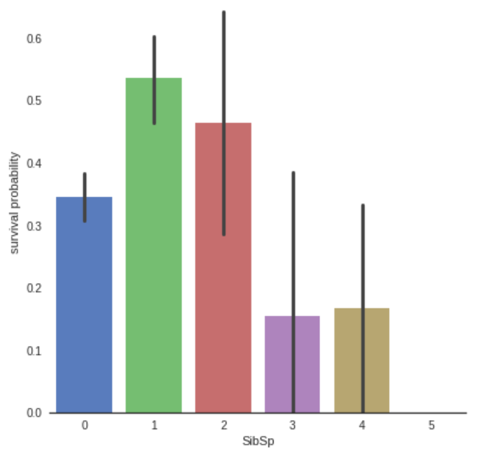
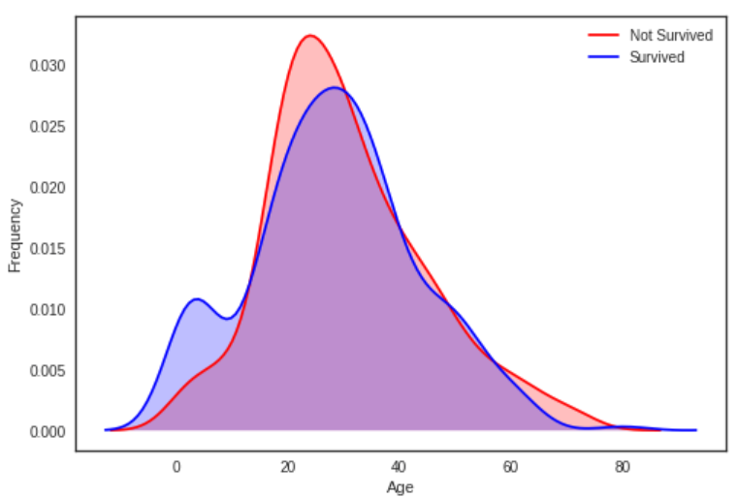
Data Exploratory

Slide 8
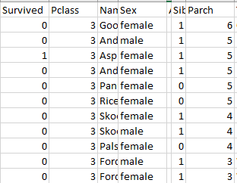
Data Exploratory
Data don’t tell the lie

Slide 9

Data
Preprocessing

Slide 10
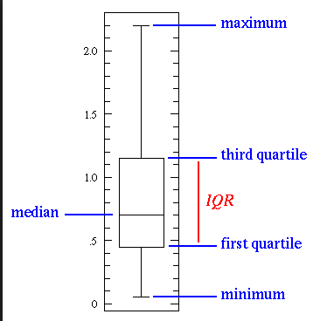
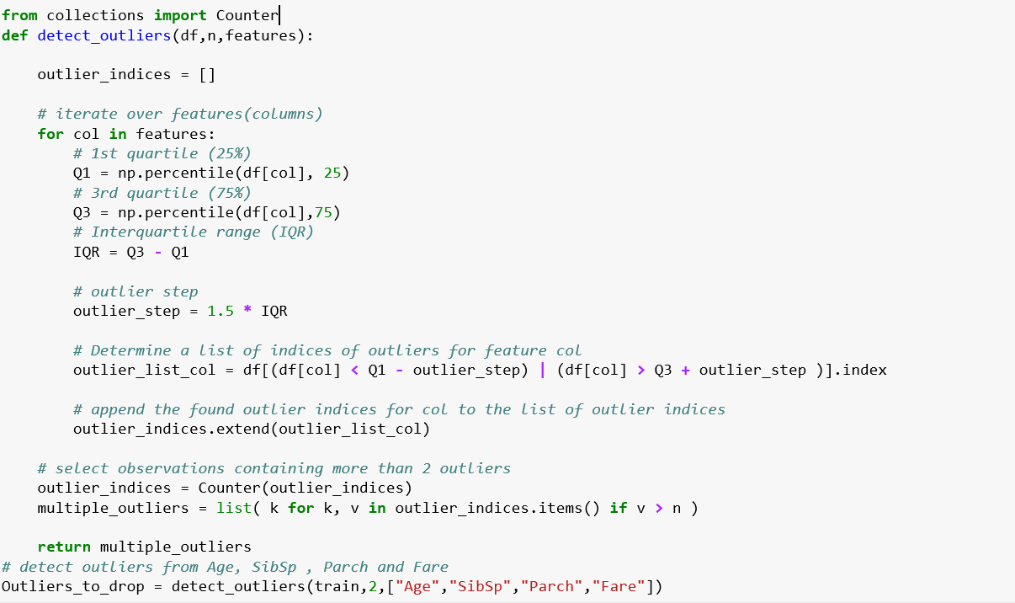

Data Preprocessing
Outlier detection
Tukey–Kramer method

Slide 11
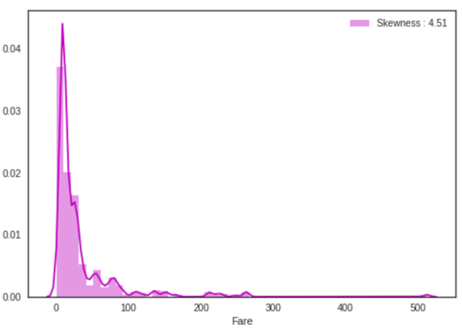
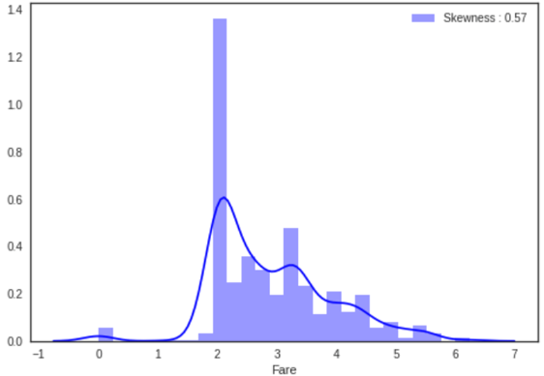
Data Preprocessing
Transformation
The “Fare” distribution is very skewed, which will lead to overweight values in the model. In this case, it’s better to transform it with the log function to reduce the skew.
Before
After

Slide 12
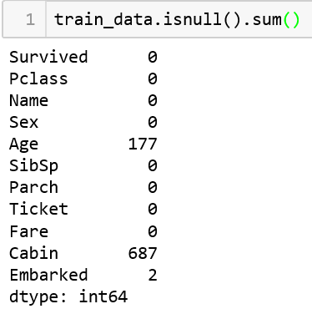
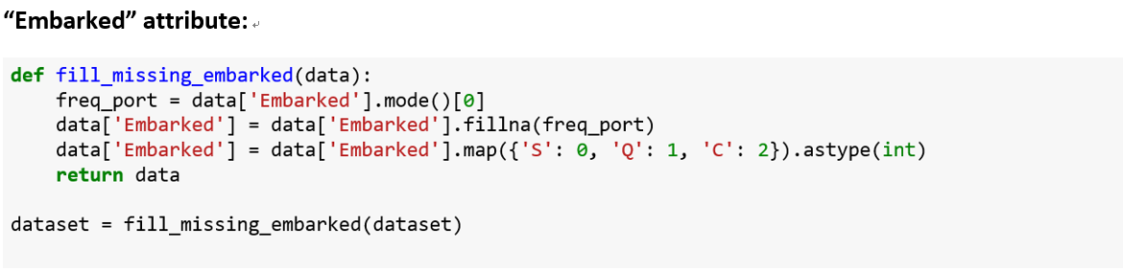
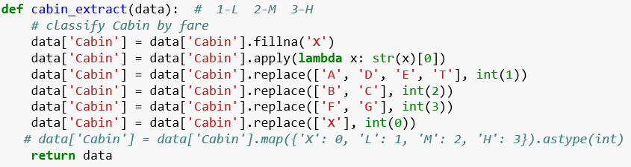
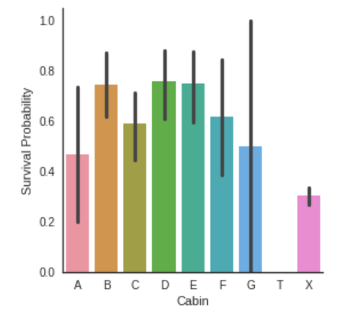
Data Preprocessing
Missing Value
Embarked & Cabin

Slide 13
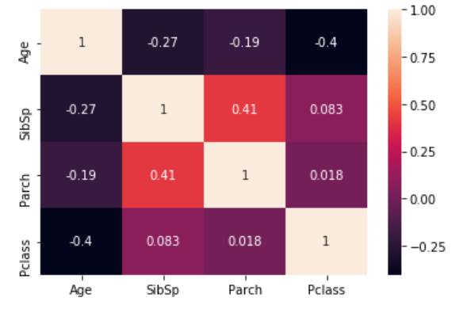
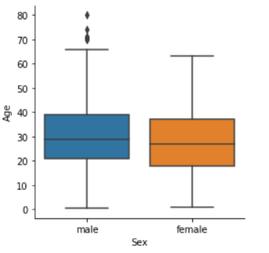
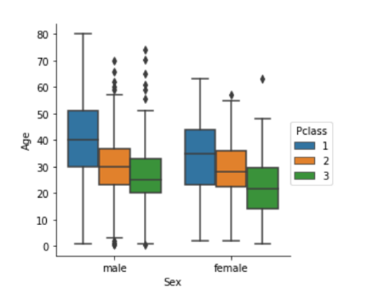
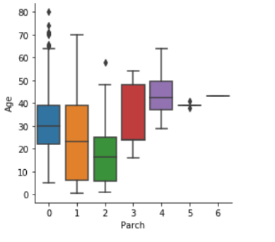
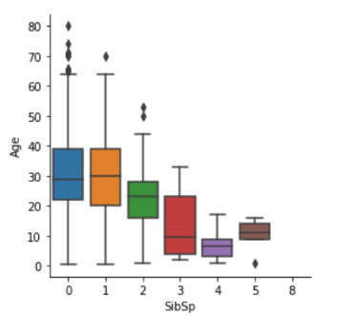
Data Preprocessing
Missing Value
Age
1st class passengers are older than 2nd class passengers who are also older than 3rd class.
the more a passenger has parents/children the older he is and the more a passenger has siblings/spouses the younger he is.

Slide 14
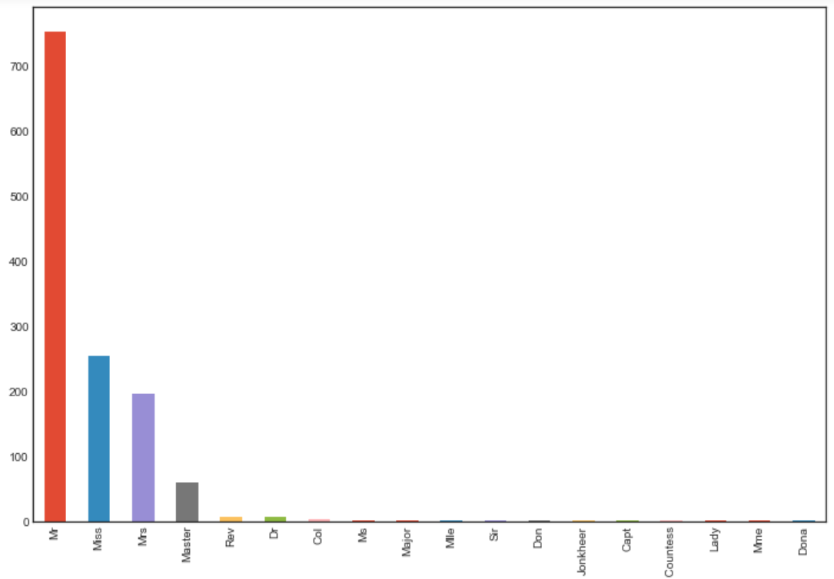
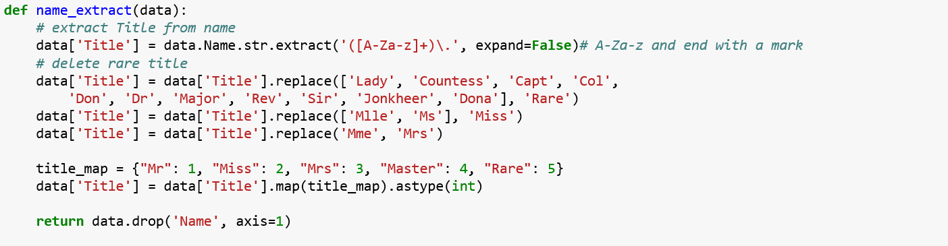
Data Preprocessing
Feature Engineering
Title

Slide 15
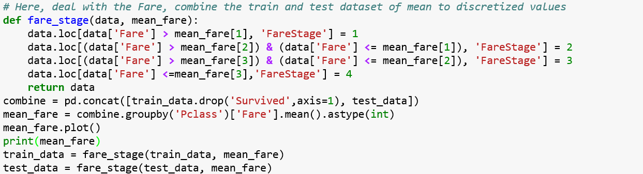
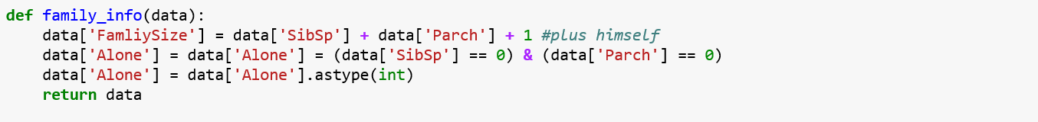
Data Preprocessing
Feature Engineering
Fare_Stage & Family & Alone

Slide 16
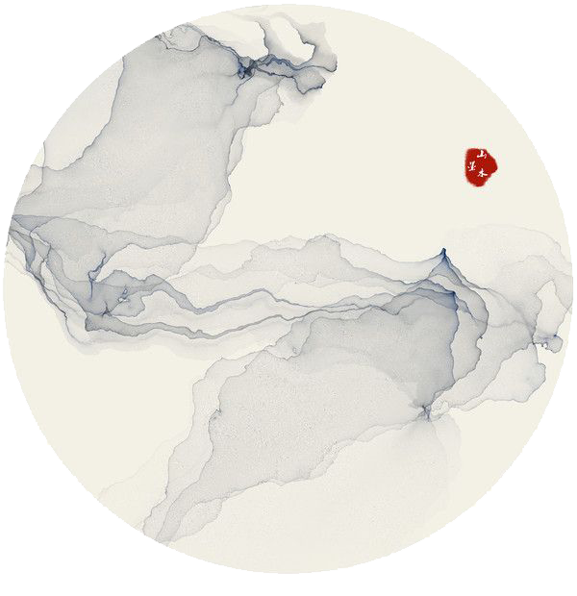
Model
Building

Slide 17
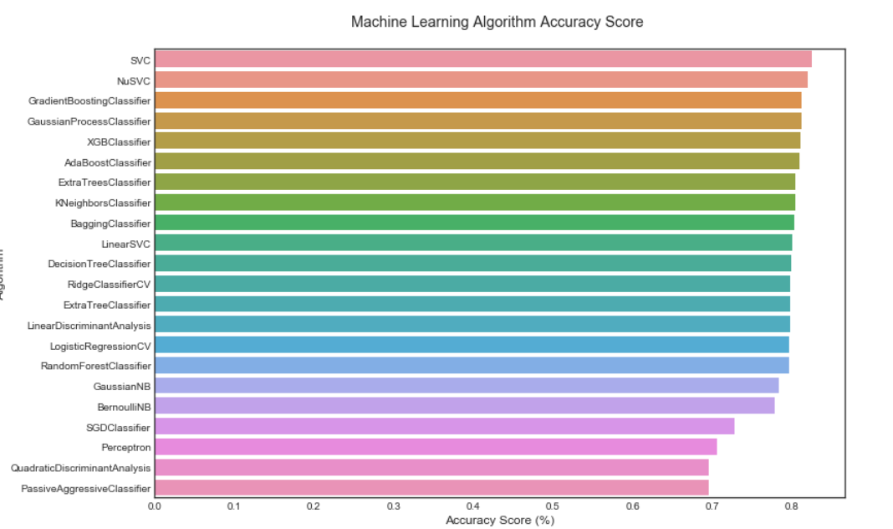


Model Building
Model Selection

Slide 18
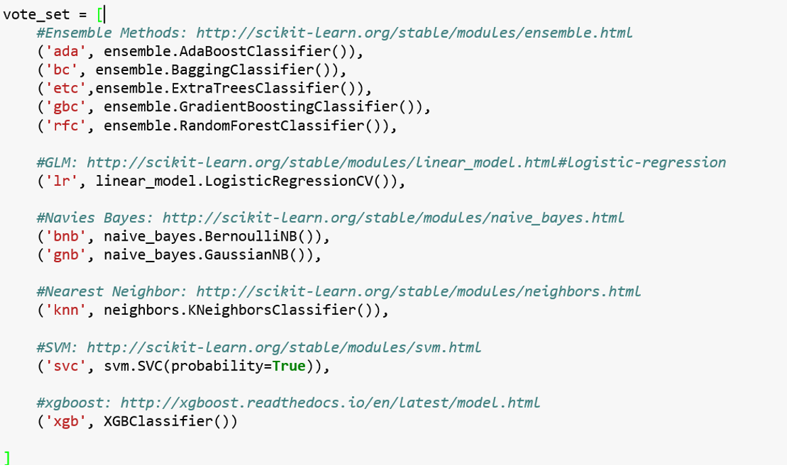
Model Building
Model Selection

Slide 19
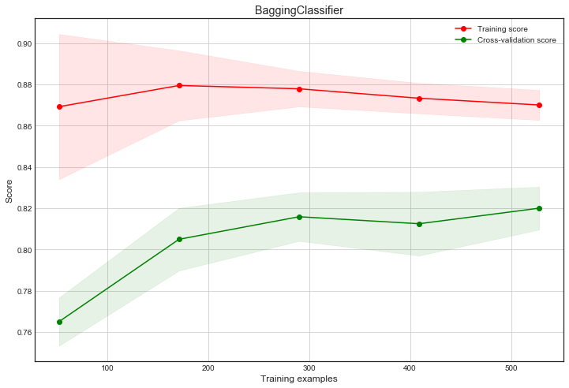
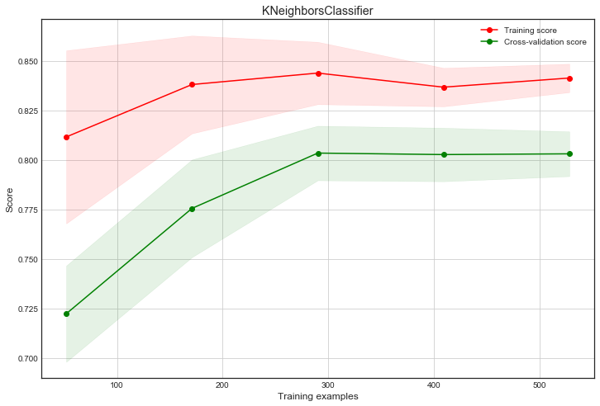
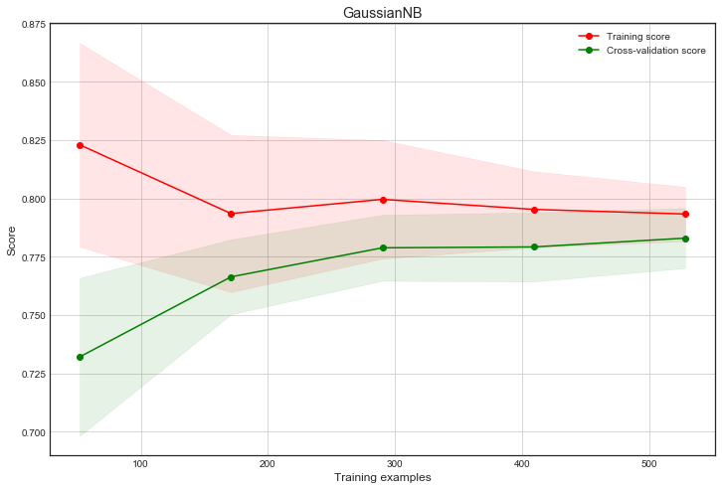
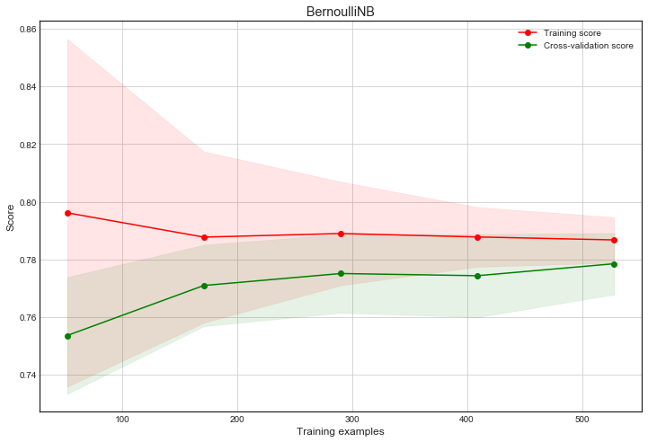
Model Building
Learning Curve

Slide 20
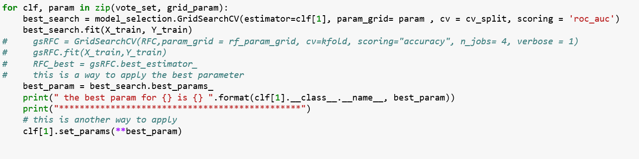
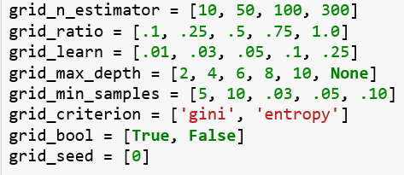
Model Building
Parameter Tuning
GridSearchCV exhaustively considers all parameter combinations to
search the hyper-parameter for the best cross validation score.

Slide 21
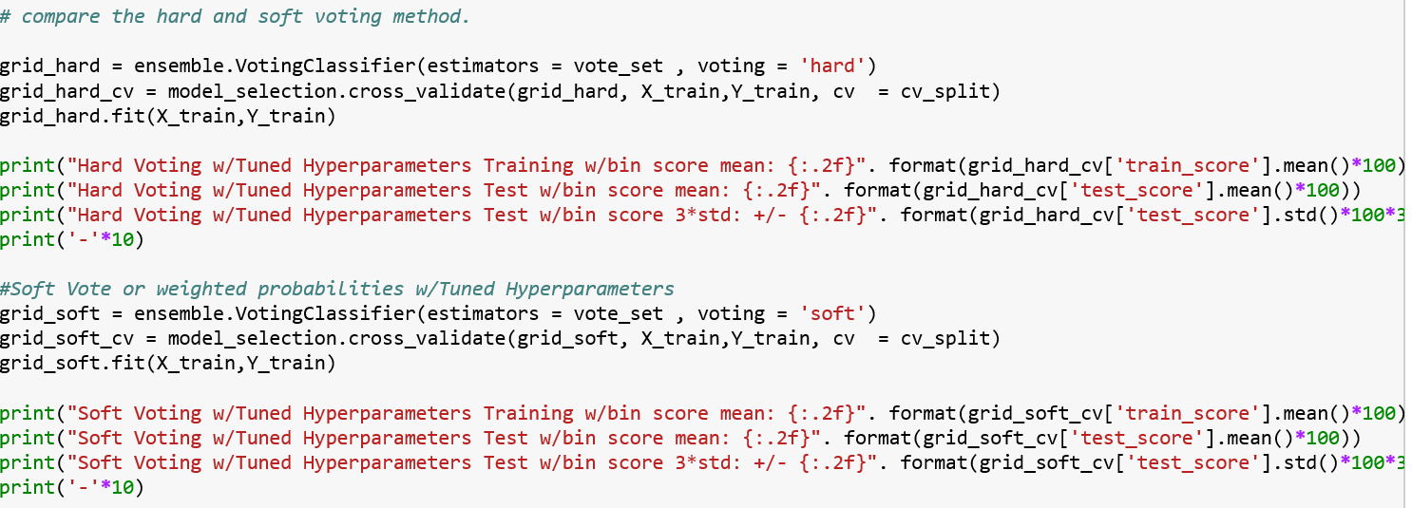
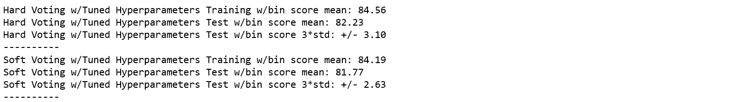
Model Building
VotingClassifier
Hard voting VS Soft voting
If 'hard', uses predicted class labels for majority rule voting.
Else if 'soft', predicts the class label based on the argmax of the sums of the predicted probabilities.

Slide 22


Thank You

